Slide 1

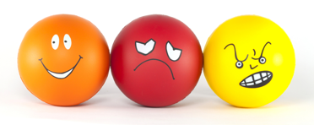
MSc Translational Neurosciences 2023
SELF-HARM BEHAVIOUR:
UNDERSTANDING PRESENTATION, MOTIVES
AND COGNITIVE MECHANISMS
Martina Di Simplicio
Mood Instability Research team
Division of Psychiatry
Department of Brain Sciences
Notes:
CHANGE BACKGROUND PICTURE

Slide 2

Learning Objectives
Understanding the multiple factors that determine complex psychopathological behaviours (e.g. self-harm)
Understanding how cognitive mechanisms can drive behaviour (e.g. self-harm)
Gaining a basic understanding of the role of cognitive modalities, in particular mental imagery, in psychopathology and behaviour
Reflecting on stigma and barriers to accessing support for young people with experiences of self-harm behaviour (lived experience Q&A session / video resources)

Slide 3
Questions in pairs & discussion
Speak to the person sitting next to you for 5 min and answer / discuss these questions to the best of your knowledge:
Is self-harm a psychiatric disorder?
Does self-harm always need treatment (physical, pharmacological, psychological)?
Do young women self-harm more than young men?
What is the relationship between self-harm and suicide?

Slide 4
SH epidemiology - key points
Transdiagnostic
Not a mental health disorder; although Non Suicidal Self-Injury (NSSI) Disorder could be)
Factors associate with self-harm: SES, social isolation and lack of support, negative life events, childhood emotional, physical or sexual abuse
Psychological characteristics: entrapment, lack of belonging / perceiving oneself as a burden, black and white thinking, low self-esteem, impulsivity, hopelessness, difficulties in problem-solving, poor emotion regulation skills
Repetition: hard to predict; more likely in those with depression, substance misuse.
Impact on functional outcomes
Gender?
SH most important risk factor for suicide; Iceberg model of SH/suicide; SH or NSSI?; Shared and distinct factors

Slide 5
Cognitive Mechanisms in Self-harm
Slides and work by Rachel Rodrigues

Slide 6
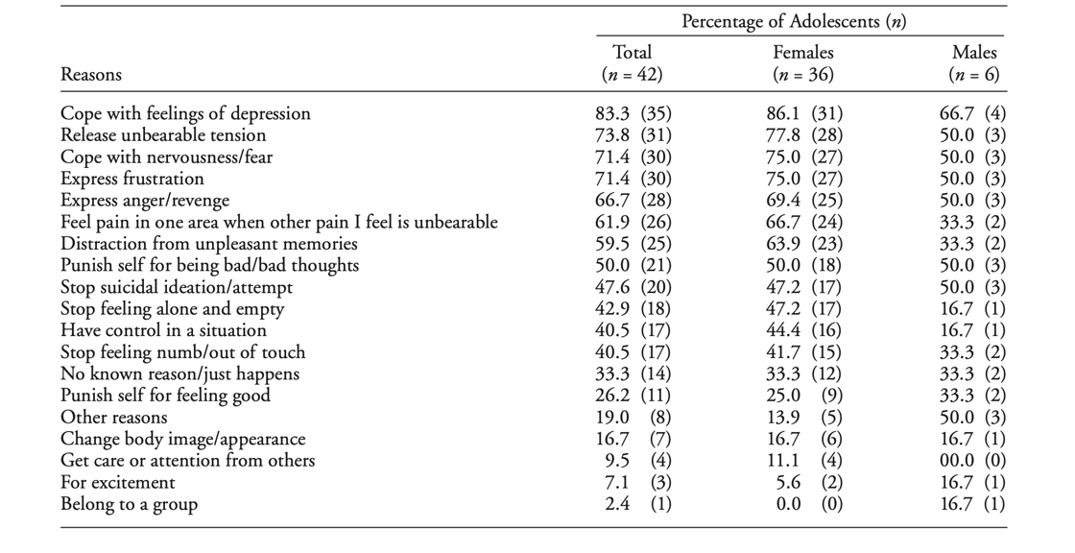
Reasons for Self-harm
Nixon et al (2002)

Slide 7
What we don’t know:
What we don’t know…
Who will continue self-harming?
Why can’t you just stop?
Urge / Obsession
Addictive
Urge / Obsession
Relapse
Can’t / Don’t want to stop
Coping mechanism
Hiding / Shame
Getting worse / Not enough
Davis et al (2019)
Notes:
First, lived experience accounts describing that self-harm can sometimes feel ‘addictive’ and something that you can’t stop even if you want to, suggesting similarities with reward and motivation processing biases present in addiction.

Slide 8
Cognitive mechanisms:
Reinforcing | Addictive | Impulsive | Compulsive
Nock (2002) Chapman (2009) Gardner et al. (2021) Bryant et al. (2021) | Nixon et al. (2002) Davis et al. (2019) Riquino et al. (2020) | Lockwood et al. (2017) | Lutz et al. (2021) Miller et al. (2021)
Addiction model of self-harm behaviour?

Slide 9
Other behaviours?
Binge-purging behaviour:
Often described as serving similar functions to self-harm, e.g. coping with distress, reducing negative affect (Islam et al., 2015; Warne et al., 2021)
Often concurrent to self-harm behaviour
Individuals can describe switching between both
Young people with both self-harm and disordered eating present with increased risk of young death, as well as greater use of health services (John et al., 2021).

Slide 10
Intro
Overview
1.
2.
3.
Reinforcing
Addictive
4.
5.
Impulsive & Compulsive
Summary

Slide 11
Nock’s Four Function Model
Negative Reinforcement
Positive Reinforcement
Intrapersonal
Reduce negative emotions
Interpersonal
Remove self from situations
Intrapersonal
Increase positive emotions
Interpersonal
Gain support or communicate
SITBI scale to measure negative / positive reinforcement drivers (Nock, 2009; Gardner et al., 2021)
Automatic positive and negative reinforcement can occur independently and simultaneously (Franklin et al., 2013)
Positive reinforcement less characterised, including the relationship with reward processing
Notes:
Intrapersonal reinforcement predicts repetitive self harm, not social reinforcement

Slide 12
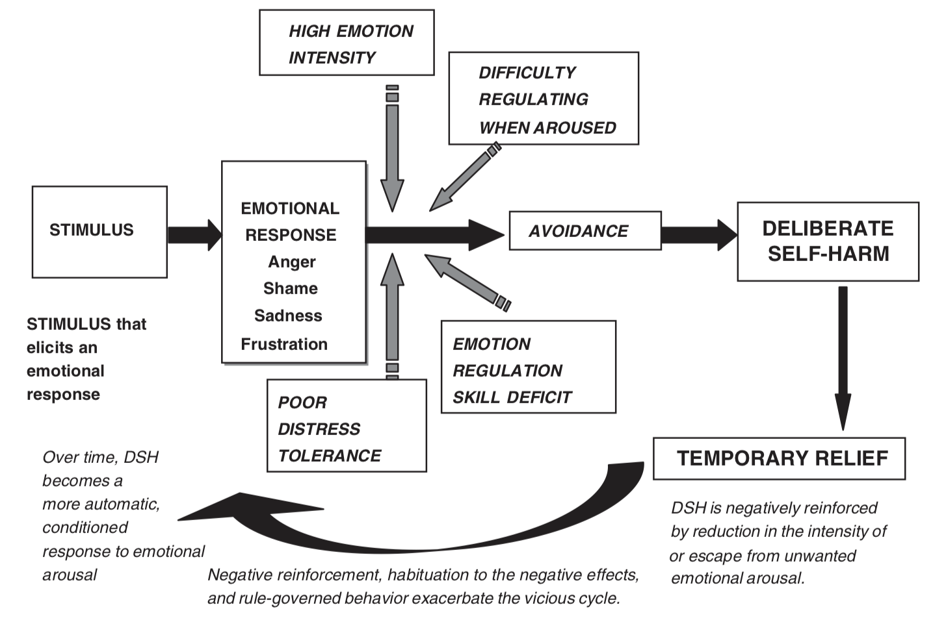
Negative reinforcement example
Chapman, Gratz & Brown (2006)

Slide 13
Intro
Overview
1.
2.
3.
Reinforcing
Addictive
4.
5.
Impulsive & Compulsive
Summary

Slide 14
Themes Found in Online Forums
Relapse
Urge / Obsession
Coping mechanism
Can’t / Don’t want to stop
Getting worse / Not enough
Hiding / Shame
Davis et al (2019)
Notes:
Davis study - analysed posts on online forums, identified six themes: “Urge/Obsession”, “Relapse”, “Can’t/Don’t want to stop”, “Coping mechanism”, “Hiding/Shame”, and “Getting worse/Not enough”

Slide 15
Systematic review of reward processing
abnormalities in SH behaviour
Cue reactivity:
attention bias for SH cues relative to neutral cues (Riquino et al., 2020)
greater OFC activation while viewing self-harm images compared to HCs (Plener et al., 2012; Hooley et al., 2020)
Reward anticipation and consumption:
both greater (Poon et al., 2018; Vega et al., 2018) and lower (Case et al., 2021) neural response in reward regions during monetary gain compared with controls.
lower activation in the putamen, amygdala and OFC than HCs during monetary anticipation (Sauder et al., 2016)
Reward-based learning in individuals with SH:
more perseverative errors in a Probabilistic Reversal Learning Task than controls (Lutz et al., 2021), especially adolescents with repetitive NSSI (4+ episodes a year)
driven by depression? (Zhang et al., 2022)
Not controlled for depression
Rodrigues, Waheed, Amaralingam, Yavuz, Thana, Lingford-Hughes & Di Simplicio, in preparation
https://www.crd.york.ac.uk/prospero/display_record.php?ID=CRD42019132053

Slide 16
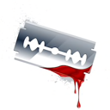
Attention bias
Attention Bias to Self-harm Cues
Motivation
Craving / Urge
Review of attention bias in addiction (Field & Cox, 2008)

Slide 17
Motivational imagery
Imagery and craving
Evidence from addiction studies (cocaine: Kilts et al., 2001; cigarettes: Hersland et al., 2007; Heishman et al., 2010; alcohol: Connor et al., 2014)
Motivation
Mental imagery
Craving / Urge

Slide 18

Self-harm imagery
Imagery commonly associated with self-harm
Intrusive imagery prior to SH
Reported by 91% university students who self-harmed (Hasking et al., 2017)
1/3 of general population sample completing online survey on imagery (Wesslau et al., 2015)
Vivid, compelling, real-like
Can also be dynamic (played out like a movie)
1st person perspective

Slide 19

SH formulation
1. Contributing factors
Mother drinking; left home age 15
2. Triggers
I can’t resist it; it’s the only way to feel better; relief
Argument with sister on the phone
3. Emotions
4. Cognitions
Angry, sad, out of control
It’s all my fault;
I have to do it (SH)
7. Maintenance factors
Felt guilty
Feeling better didn’t last
5. SH behaviour description
Cutting on forearm
6. Function
To get back in control
To feel better
To punish myself
Imaginator trial,
Di Simplicio et al., 2020

Slide 20
Imagery and SH
1. Contributing factors
Mother drinking; left home age 15
2. Triggers
Argument with sister on the phone
Motivational amplifier
3. Emotions
4. Cognitions
Relief
Peace
Control
I have to do it; I can’t wait to be alone to do it
5. SH behaviour description
Cutting on forearm
Imaginator trial,
Di Simplicio et al., 2020

Slide 21
Motivational role of imagery in SH
Can mental images of SH influence engaging in SH behaviour?
Images associate with SH enactment (Baker & Lewis, 2013)
Images of SH more present in those who attempted SH/suicide than those who only thought about it (Wetherall et al., 2018)
Small daily diary study of individuals with NSSID, more SH episodes reported in days with SH imagery (Cloos et al., 2019)
Distressing imagery = not acting on it vs. comforting imagery = acting on it (McEvoy et al., 2017)

Slide 22
Investigating Motivational Abnormalities Guiding Self-Harm Behaviour in Young People
Compared to controls, do young people with experiences of SH behaviour present with biases in:
anticipation of SH cues (incentive value) and / other monetary / social rewards?
attention towards SH cues?
general reinforcement learning processes?
Exploratory: are SH characteristics (including mental imagery) associated with motivational processes abnormalities?
https://www.imaginestudy.org/

Slide 23
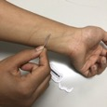
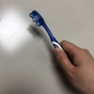





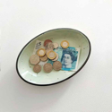
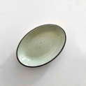

Incentive Delay Task
Too
early
Try to be faster
Quick response
Fixation
Cue
Feedback
Neutral
+
+
Self-harm
Note: results replicated in separate sample following stress induction with TSST
+
+
Positive social
+
+
Win money
No btw group differences in RTs or accuracy.
No evidence of incentive sensitisation / reward anticipation biases in YP with SH.
Rodrigues, Yavuz, Pascual, Lingford-Hughes & Di Simplicio (in preparation)

Slide 24



Dot Probe Task
Fixation
self-harm + neutral cues
Dot probe
+
0.5s
0.2s or 2s
response
neutral + neutral cues

Slide 25
Attention
*
Avoidance
Attentional avoidance to substances cues has ben associated with recovery in addiction
Rodrigues, Mehesz, Lingford-Hughes & Di Simplicio (JAD, 2023)

Slide 26
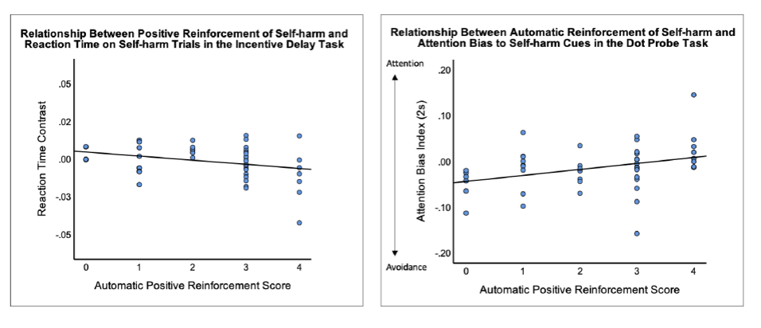
Exploring associations with SH characteristics
Individuals who endorse positive reinforcement as a driver of SH may present with incentive sensitisation of SH cues?
Yavuz, Rodrigues, Pascual, Lingford-Hughes & Di Simplicio (in prep)

Slide 27
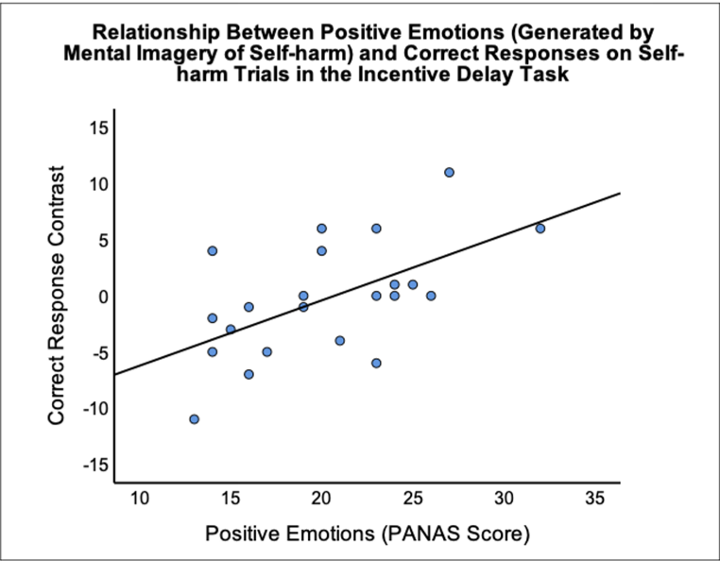
Exploring associations with SH characteristics
Medium correlation with SH mental imagery ratings:
>>> those experiencing stronger positive emotions after SH mental imagery more accurate responses in SH vs neutral trials
Rodrigues, Yavuz, Pascual, Lingford-Hughes & Di Simplicio (in preparation)

Slide 28
Summary
Self-harm is a reinforcing behaviour
Most people described it as a way to regulate emotions; some people experience it as “addictive”
Reward mechanisms (cues incentivisation and attention biases) might be involved, but only in a sub-group of those who self-harm
What is the role of avoidance of self-harm cues?
More research needed to understand the role of self-harm mental imagery
Similar mechanism could be extended to other dysregulated behaviours such as binging and purging?

Slide 29
Impulsivity & Compulsivity Constructs
Impulsivity
Compulsivity
‘[Where] actions are persistently repeated, despite adverse consequences.’
‘The tendency to act prematurely, without foresight, despite adverse consequences’
Robbins et al (2012)

Slide 30
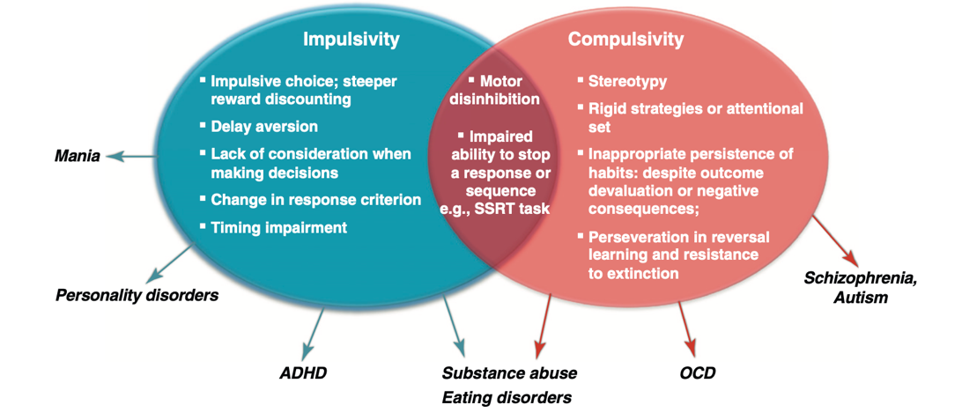
Impulsivity & Compulsivity Constructs
Robbins et al (2012)
Self-harm

Slide 31
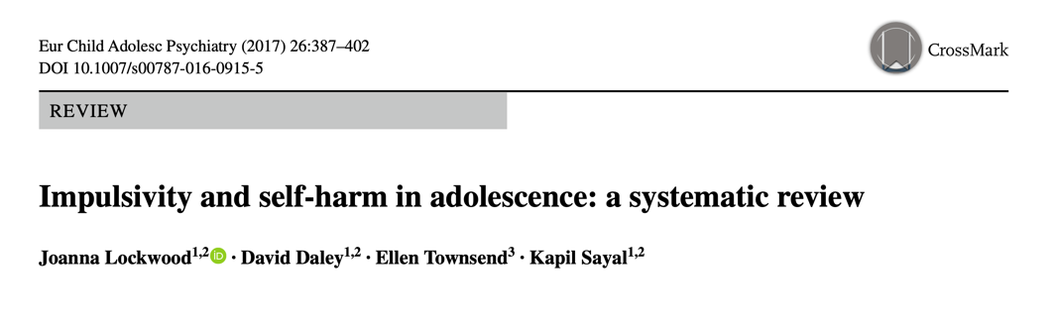
Initiation of self-harm
Mood based impulsivity (negative urgency, reacting rashly to negative affect)
Maintenance of self-harm
Cognitive facets of impulsivity (lack of planning and forethought)

Slide 32
Compulsivity (Cognitive Inflexibility)
Self-harm
Probabilistic Reversal Learning Task
Lutz et al (2021)

Slide 33
Compulsivity (Cognitive Inflexibility)
Creature of Habit Scale (COHS; Ersche et al., 2017) measures two components of habitual responding:
Routine: tendency to engage in routine behaviours (can generalise to habits)
Automaticity: tendency to engage in automatic actions (unintentional, triggered by environment cues)
Rodrigues, Lingford-Hughes, Kumar & Di Simplicio (unpublished)

Slide 34
Compulsivity (Cognitive Inflexibility)
Lutz et al (2021)
Young people with SH made less perseveration errors compared to the HC group.
No between-group differences when splitting by repetitive and sporadic SH.
Rodrigues, Cohen, Custovic, Hampshire, Kumar and Di Simplicio (in preparation)

Slide 35
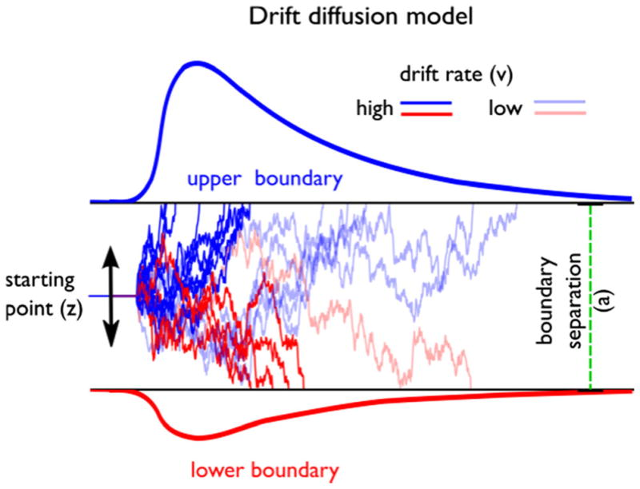
Probabilistic Reversal Learning Task: computational model
Reinforcement learning + drift diffusion model (RLDDM)
Reinforcement learning parameter:
Learning rate (alpha)
Drift diffusion parameters (decision making characteristics):
Decision threshold (a)
Drift rate (v)
Pedersen, Frank & Biele, 2017

Slide 36
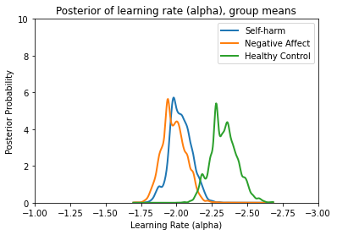
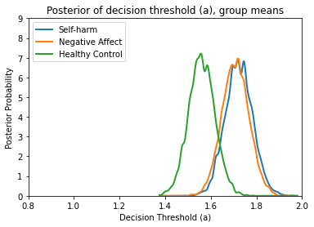
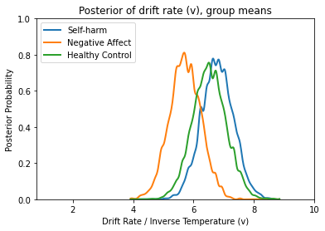
Probabilistic Reversal Learning Task: computational modelling results
Learning rate
Decision Threshold
Drift Rate
SH and NA group had a higher learning rate: greater value to more recent feedback vs reinforcement history
SH and NA group had a higher decision threshold:
similar to anxiety, cautious response style under uncertainty (Dillahunt et al., 2022)
avoiding negative feedback? YPRG comment: driven by ‘disliking the boos’
Rodrigues, Cohen, Custovic, Hampshire, Kumar and Di Simplicio (in preparation)

Slide 37
Summary
Role of compulsivity & cognitive flexibility in SH remains to be understood
Mechanisms underlying decision making (including relationships with impulsivity) appear more nuanced than expected
What is the relationship between cognitive parameters and clinical parameters?
What about individual differences?

